Slide 1

Project Title -Seasonal Agriculture Performance Analysis Student Name- Yashika College Name- Sri Guru Tegh Bahadur Institute of Management and Information Technology(GGSIPU)
AICTE STU ID : STU6a364fc0e1d141781944256

Slide 2

PROBLEM STATEMENT
Context: Agricultural productivity and profits fluctuate heavily across seasons due to changing weather conditions, water availability, and market prices.
Core Challenge: Raw agricultural datasets contain multidimensional variables (soil pH, moisture, rainfall, fertilizer, costs) that are difficult to interpret without systematic analytics.
Objective: Conduct an end-to-end data analytics study to identify seasonal performance trends, evaluate irrigation efficiency, analyze disease risk factors, and determine key drivers of net profit.

Slide 3
Project Description Overview: A Python-based Data Analytics project evaluating seasonal crop yield, operational expenditures, and revenue metrics. Dataset Scale: 4,000 distinct farm records across 28 analytical features. Key Analytical Phases: .Data Cleaning & Imputation (handling missing values in environmental metrics). .Univariate & Bivariate Exploratory Data Analysis (EDA). .Seasonal Performance & Efficiency Comparisons. .Correlation Matrix & Factor Identification.

Slide 4

WHO ARE THE END USERS?
Agricultural Policy Makers: To design targeted crop subsidies, regional water allocation plans, and seasonal farm relief programs.
Farmers & Cooperatives: To make data-backed decisions on optimal crop selection, planting schedules, and irrigation method adoption.
Agri-Tech & Financial Institutions: To evaluate farm credit risk, build insurance models, and forecast regional yield expectations.

Slide 5

Technology Used
Programming Language: Python 3.x
Data Manipulation: Pandas, NumPy
Data Visualization: Matplotlib, Seaborn
Development Environment: Google Colab / Visual Studio Code
Version Control & Repository: GitHub

Slide 6
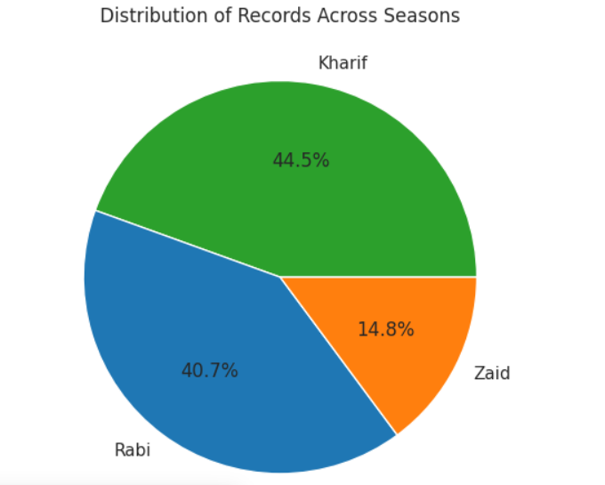
RESULTS
Data Quality & Hygiene:
Detected and resolved 120 missing values (Rainfall_mm: 48, Soil_Moisture_pct: 40, Yield_Tonnes_Ha: 32) using median imputation.
Confirmed 0 duplicate records, ensuring high dataset integrity.
Seasonal Record Breakdown:
Kharif Season: Dominates the dataset with 1,779 records (44.5%).
Rabi Season: Represents 1,627 records (40.7%).
Zaid Season: Accounts for 594 records (14.8%).

Slide 7
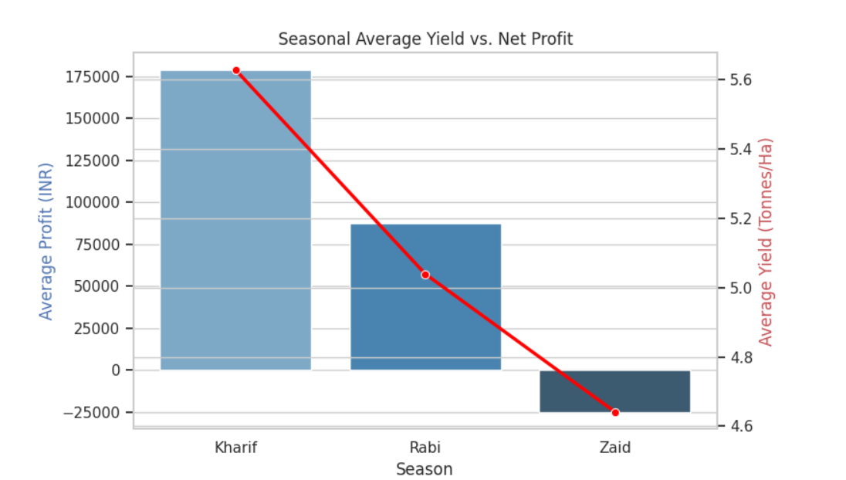
RESULTS
Kharif (Monsoon Season):
Achieved the highest average profit (₹1,78,914.65) and yield (5.63 Tonnes/Ha), driven by high average rainfall (849.20 mm).
Rabi (Winter Season):
Delivered steady financial returns with an average profit of ₹87,689.47 and yield of 5.04 Tonnes/Ha.
Zaid (Summer Season):
Generated a net average loss (-₹24,804.82) and lowest yield (4.64 Tonnes/Ha) due to extreme heat stress and heavy water demand (6,419.89 m³).

Slide 8
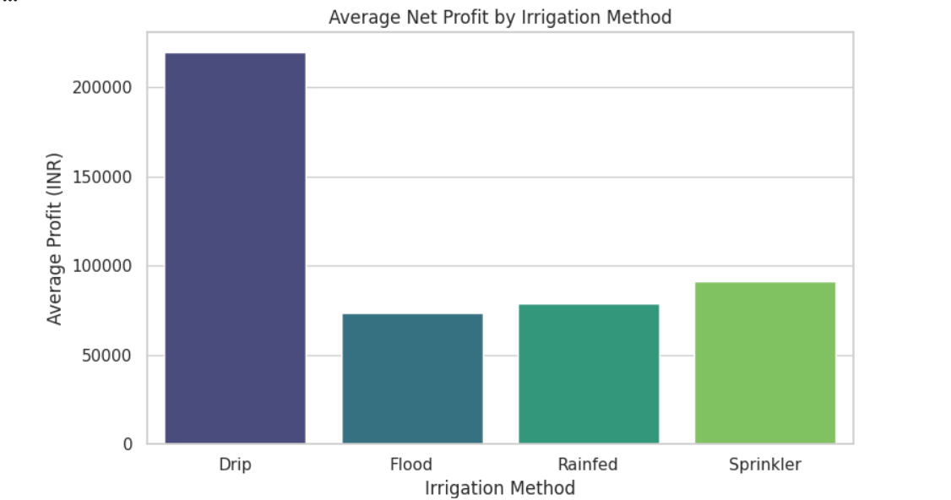
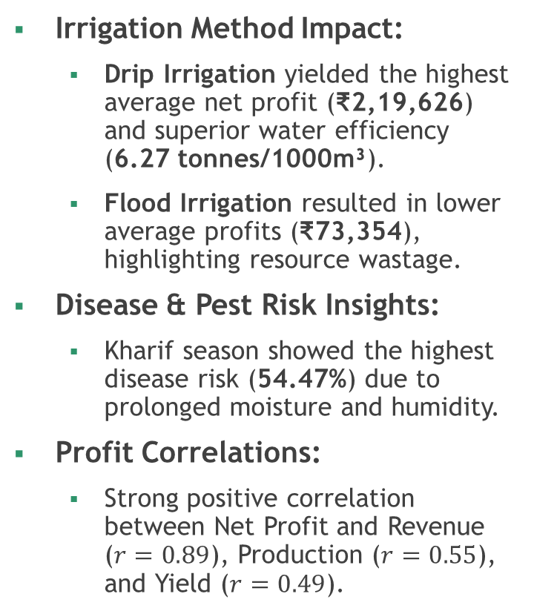
RESULTS
Irrigation Method Impact:
Drip Irrigation yielded the highest average net profit (₹2,19,626) and superior water efficiency (6.27 tonnes/1000m³).
Flood Irrigation resulted in lower average profits (₹73,354), highlighting resource wastage.
Disease & Pest Risk Insights:
Kharif season showed the highest disease risk (54.47%) due to prolonged moisture and humidity.
Profit Correlations:
Strong positive correlation between Net Profit and Revenue ($r=0.89$), Production ($r=0.55$), and Yield ($r=0.49$).

Slide 9
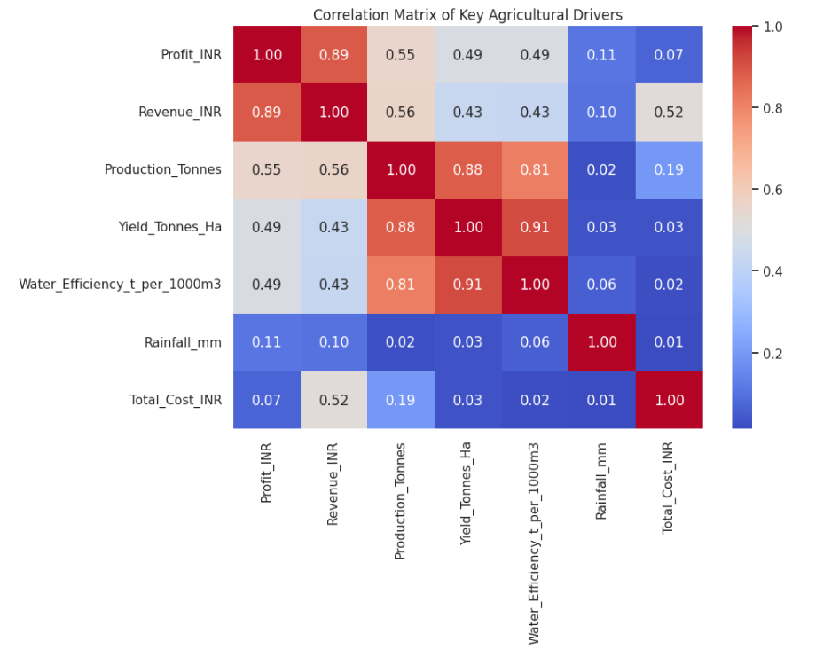
RESULTS

Slide 10
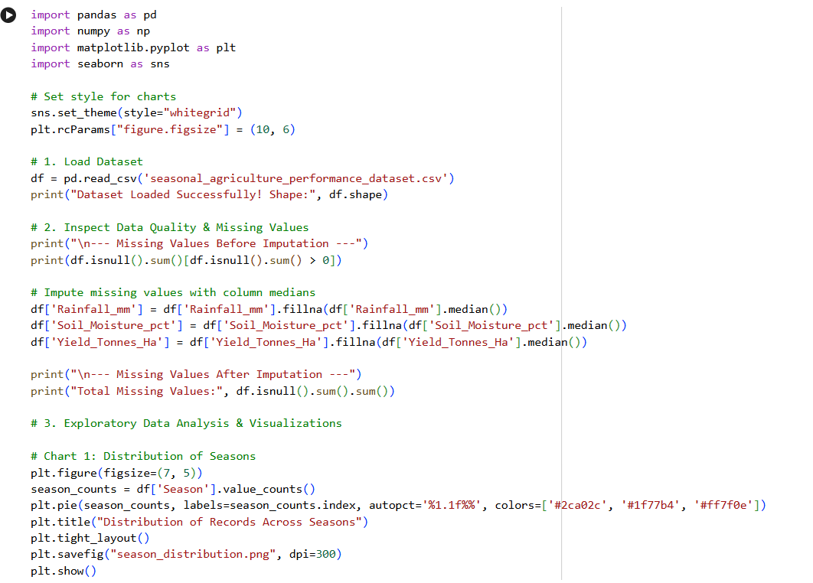
RESULTS (Code Screenshot)

Slide 11
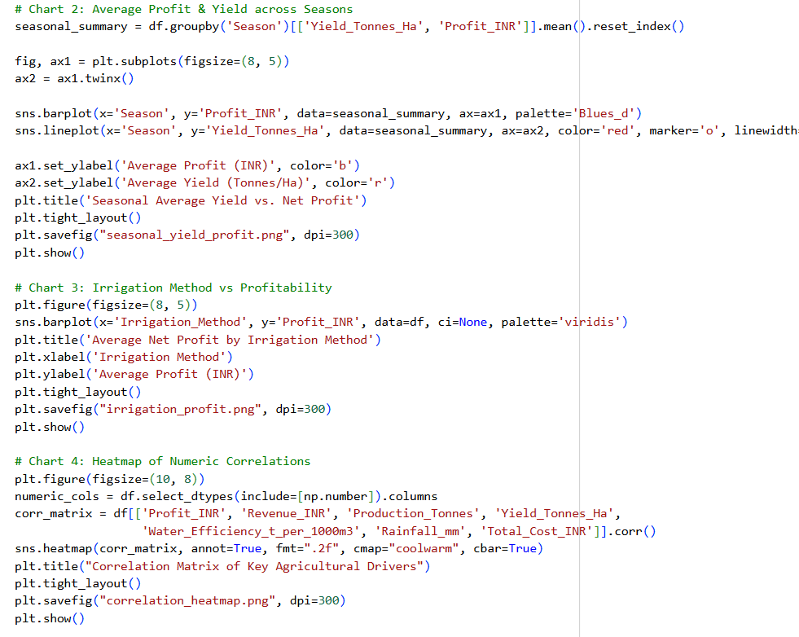

Slide 12
Future scope
Predictive Yield Modeling: Implement Supervised Machine Learning algorithms (Random Forest, XGBoost) to predict profit before sowing.
Interactive Web Dashboard: Build a Streamlit or Power BI dashboard allowing farmers to filter inputs by district and soil type.
Real-time Advisory API: Integrate live weather forecasting and soil sensor metrics for dynamic crop recommendations.

Slide 13
GitHub Link
https://github.com/SharmaYashika-bot/Seasonal-Agriculture-Performance-Analysis

Slide 14
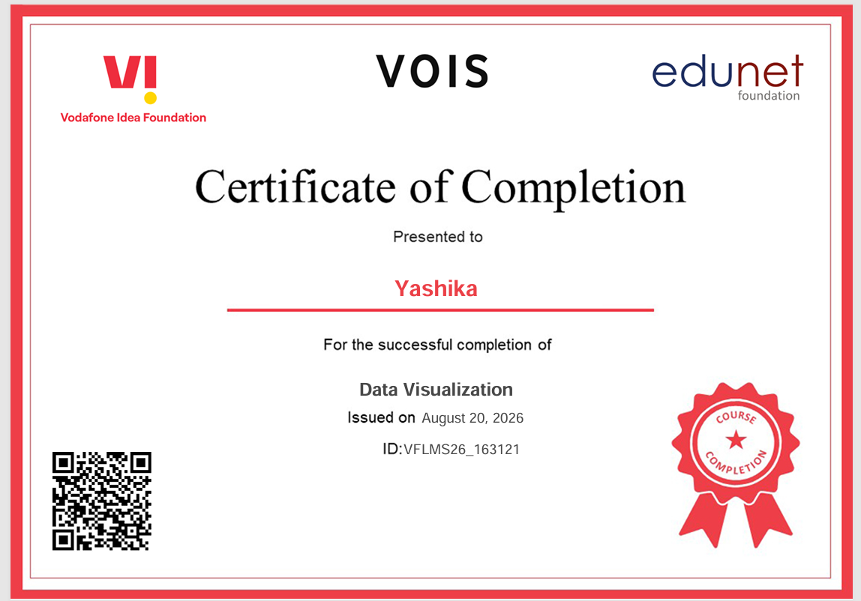
VOIS Course completion certificate - Course name- Data Visualization

Slide 15
Thank you
.
.

